Slide 1

Northeast SARE
Farmer Grant Program
Candice Huber
Farmer and Partnership Grant Programs Coordinator
Northeast SARE
South Burlington, Vermont

Slide 2


Slide 3
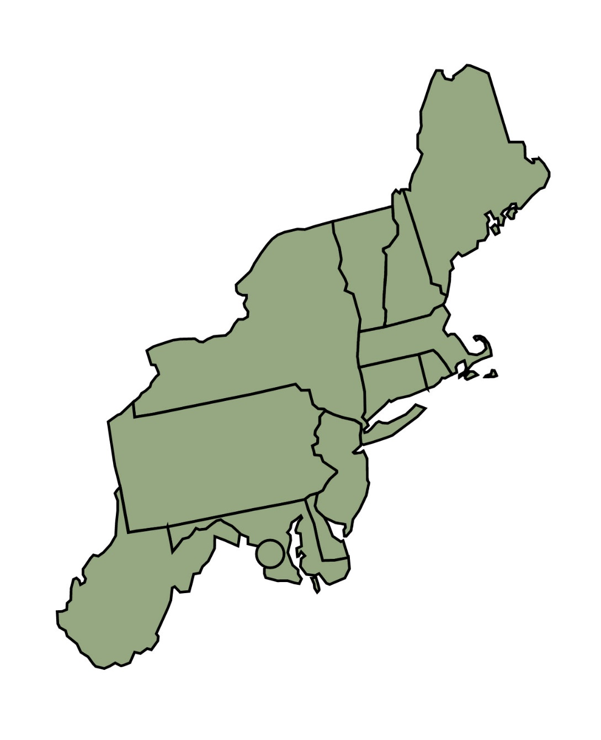

Northeast SARE serves:
Connecticut, Delaware, Maine, Maryland, Massachusetts, New Hampshire, New Jersey, New York, Pennsylvania, Rhode Island, Vermont, West Virginia, & Washington, D.C.

Slide 4
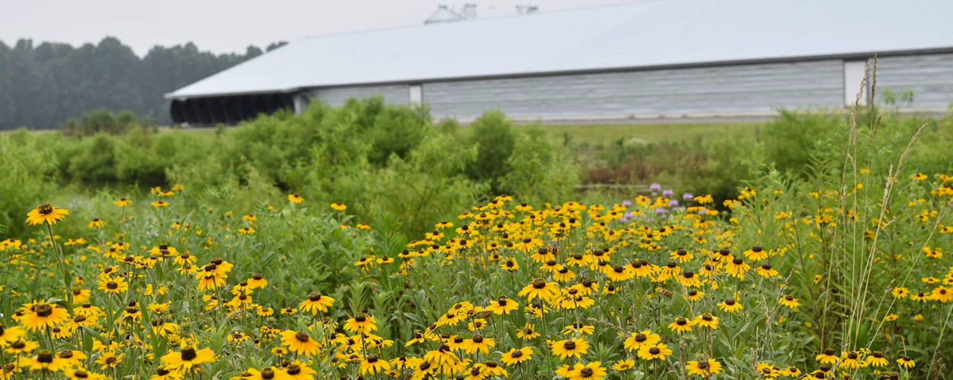
Grants and Education to Advance Sustainable Agriculture and Food Systems in the Northeast
Northeast SARE grant programs
How to write a strong proposal
Managing a funded project
Educational resources
Improving poultry farm sustainability through pollinator buffers
Tina Hill, Hill Farms, Inc., Houston, DE (FNE17-873)

Slide 5
Farmer Grant Basics
Commercial farmers in the Northeast region are eligible to apply.
The topic must addressing opportunities to improve the sustainability of farms.
Technical advisor required.
Detailed budget required: Maximum amount to request is $30,000. Awards fund are disbursed on reimbursement basis.
Projects typically run from 1-3 years (contracts begin March 1).
Applicants may only submit one proposal per year.
Proposal deadline is typically in November; submitted on line.
Detailed instructions found in Call for Proposals at northeastsare.org/FarmerGrant

Slide 6
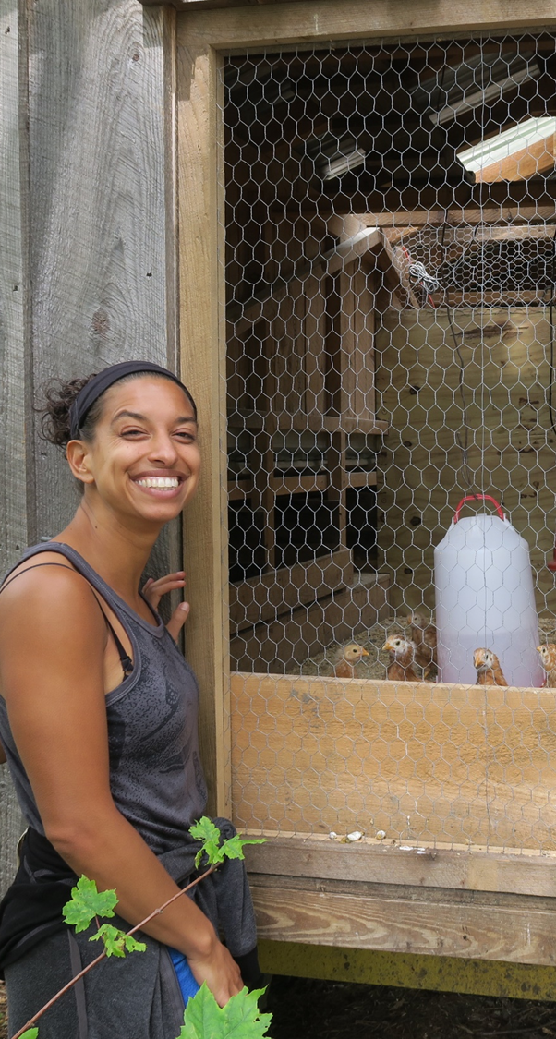
Who can apply?
All commercial farm business owners and farm employees in the Northeast region.
Farm employees need farm owner’s authorization
Farmers on farms affiliated with an institution or a nonprofit organization
Farm must have financial capacity to manage expenses – paid on reimbursement basis
Economic viability for the farmer,
fresh food for low-income families:
A manual
Leah Penniman, Soul Fire Farm, Petersburg, NY (FNE17-879)

Slide 7
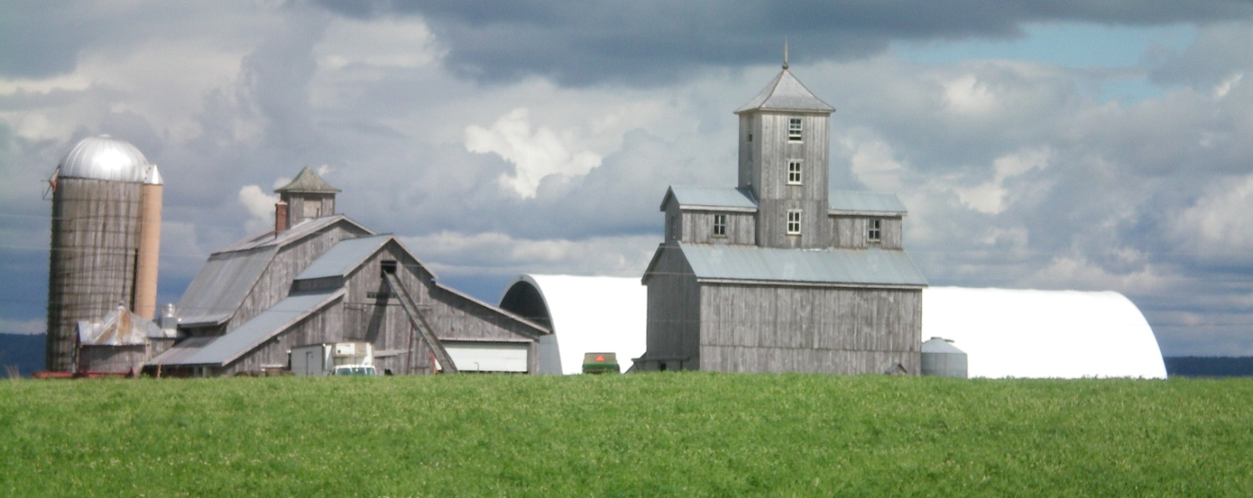
Northeast SARE’s definition of a farm
“Any place from which $1,000 or more of agricultural products were produced and sold, or normally would have been sold, during the census year.”
Northeast SARE’s Definition of Farm found at:
northeastsare.org/FarmerGrant
A Vermont farmers breeding club: developing varieties that work for us
Jack Lazor, Butterworks Farm, Westfield, VT (FNE07-613)
Resource: www.sare.org/wp-content/uploads/Northeast-SAREs-Definition-of-a-Farm.pdf
Notes:
Any place from which $1,000 or more of agricultural products were produced and sold, or normally would have been sold, during the census year.” The USDA Economic Research Service recognizes that some farms “experience low sales in a particular year due to bad weather, disease, changes in marketing strategies, or other factors.” Northeast SARE’s definition of farm includes those operations taking place in rural and urban settings, on land and in aquatic places, and at any scale (large or small) that meets the definition. Northeast SARE funds proposals that address a wide variety of agricultural practices and social issues affecting farms, farm families and farm workers. Topics are eligible for Northeast SARE funding only if the proposal describes a clear and strong connection to working farms and if there is a potential benefit to the region’s agriculture. Farms affiliated with an institution or an organization may qualify as a farm if they meet the definition above.

Slide 8
Grant proposals address at least one of the themes of sustainable agriculture:
Reduction of environmental and/ or health risks in agriculture
Improved productivity, reduction of costs and/or increase of net farm income
Conservation of soil, improvement of water quality, and protection of natural resources
Enhancement of employment in farm communities
Improvement of quality of life for farmers, their employees, and the farming community
Results of the project will benefit other farmers.

Slide 9
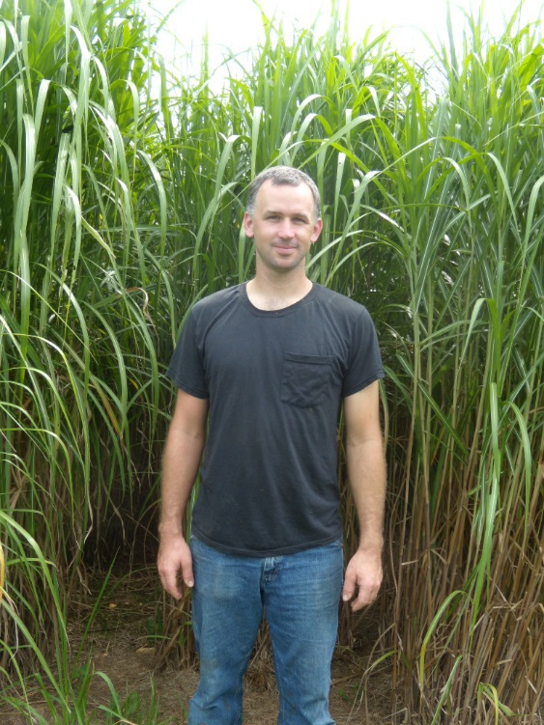
Wide range of farms, topics and methods funded
Some examples:
Aquaculture – oyster, seaweed production
Bees – hive health; pollination
Business management – purchasing cooperative
Crop production – vegetables, fruits, hemp
Education – production manual for beginning farmers; demonstrations for cut-flower weed control
Livestock – cows, goats, sheep, pigs, poultry
Natural Resources – energy efficiency
Nutrient Management – composting, cover crops
Pest Management – weed, disease and insect control
Prototypes – kosher poultry processing, grain pearling machine
Season extension – caterpillar tunnels
Establishment of Miscanthus as an Alternate Bedding Supply
Steven Harnish, Central Manor Dairy, Washington Boro, PA (FNE11-719)
Resource: projects.sare.org/search-projects/

Slide 10
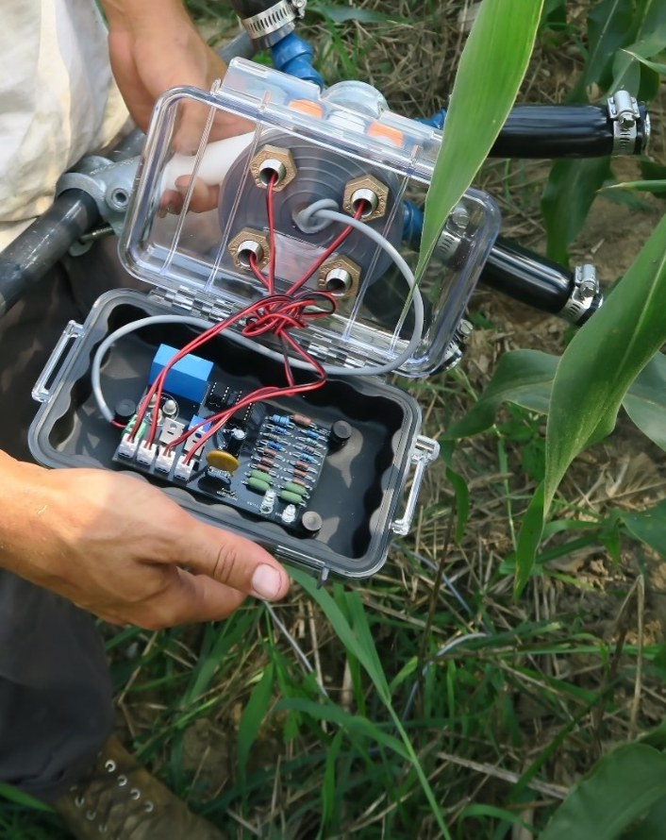
Product Development – Product Testing
Product Development: Building a new tool and testing it for effectiveness and improvements.
- Prototype plans and material lists are part of project outreach and reporting.
Product Testing: To see if a treatment or process works or can be applied in a new way
- Does not require sharing of product design.
Laser Scarecrow Prototype
Ken Elliot, Elliot Farm, Lakeville, MA (FNE18-893)

Slide 11
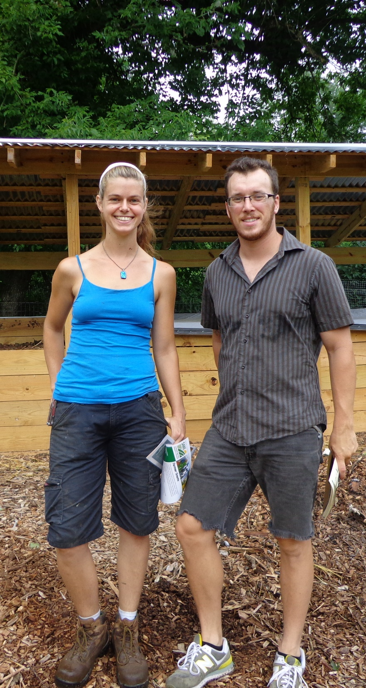
Technical Advisor Required
Extension or University specialist
Private Consultant
Veterinarian
State Agency of Agriculture staff
Company representative
Experienced farmer
Effectiveness of Aerated Static Pile to Windrow Composting on Small-Scale Farms
Emma Jagoz, Moon Valley Farm, Cockeysville, MD (FNE14-803)
Resource: www.northeastsare.org/technicaladvisor

Slide 12
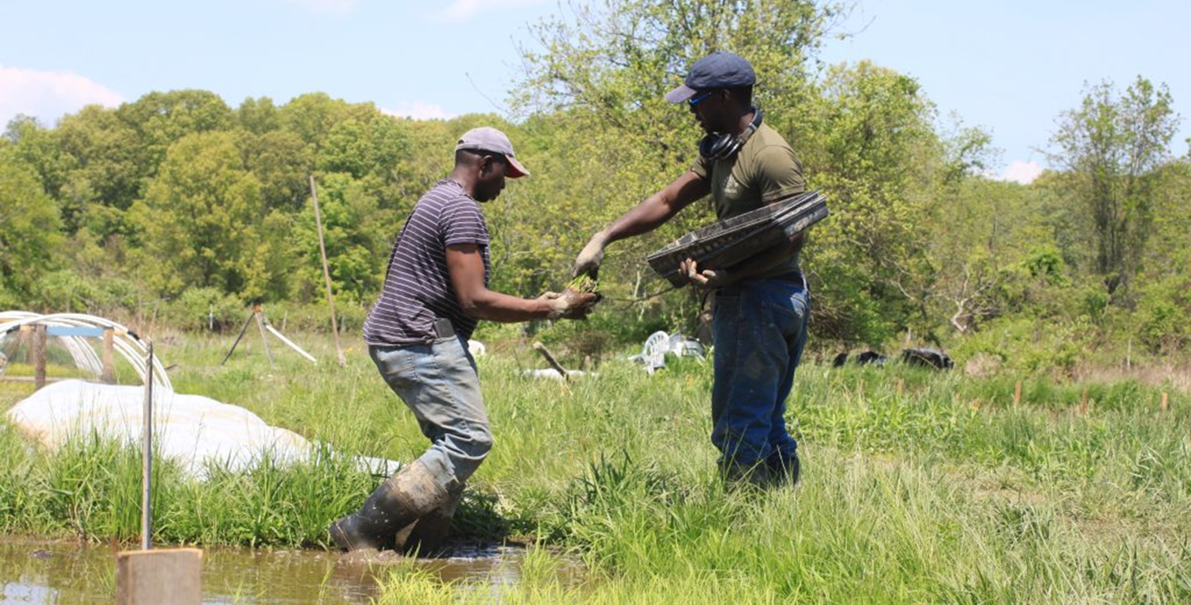
How to design your experiment
Work with technical advisor
Read the Call for Proposals
Identify your objectives and an experimental design
Identify the costs involved
“How to Conduct Research on Your Farm or Ranch” at
northeastsare.org/FarmerGrant
Evaluation of Nursery Methods on Plant Development and Grain Yield of Rice
Dawn Hoyt, Ever-Growing Family Farm,
Ulster Park, NY (FNE19-933)

Slide 13
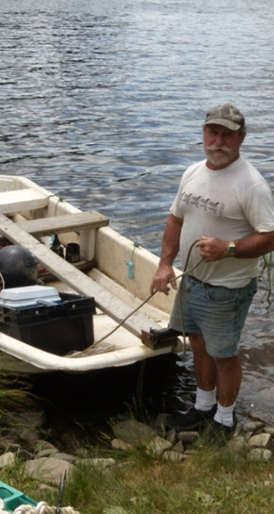
SARE does fund:
Personnel
Materials and supplies
Travel
Printing and publications
Other direct costs
  Equipment rental
  Testing and analyses
  Consultants fees and travel
  Presenting at conferences
Exploring Husbandry and Equipment Solutions to Infestations of Polydora sp. on a Maine Oyster Farm
Jesse Leach
Bagaduce River Oyster Company
Penobscott, ME (FNE09-663)
All expenses must be specific to the project.

Slide 14
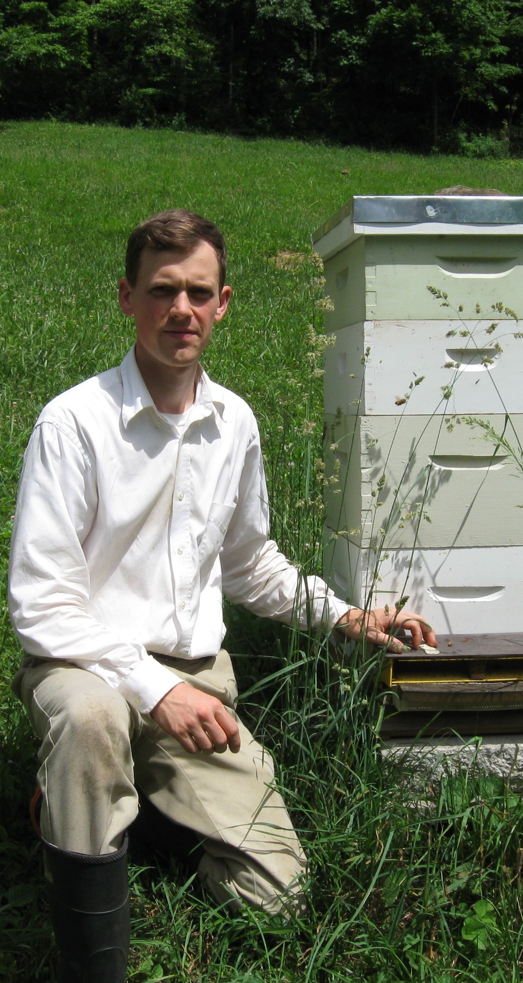
SARE does not fund:
Business or enterprise start-up expenses
Structures and major renovations
Purchase of farm equipment normal for your operation
Operating expenses normally present
Motorized vehicles
Cell phones/ cell phone charges
Food unless part of training/meeting
Promotional giveaways or gifts
Purchases made before or after the grant contract period
Defining honeybee pollen sources in Appalachia, July through October
Michael Staddon, Honey Glen, Salem, WV (FNE17-882)

Slide 15
Sample Proposal Questions
Proposal summary (250 words)
What resources, experience, skills and capacity do you bring to the project? (300 words)
What is the problem or opportunity, why is it important, and what is your proposed solution? (750 words)
What efforts have been made by others to solve the problem or take advantage of this opportunity? (750 words)
Citation list (750 words )
What is/are your project’s objective(s)? (200 words)
Materials and methods (1200 words)
Outreach (250 words)
Timeline (500 words)

Slide 16
Required attachments
Budget justification and Narrative –use Budget Template (Excel file) found at northeastsare.org/FarmerGrant
Letter of Commitment from Technical Advisor describing their expertise, role, and their view of the importance of project
Other attachments for specific cases

Slide 17
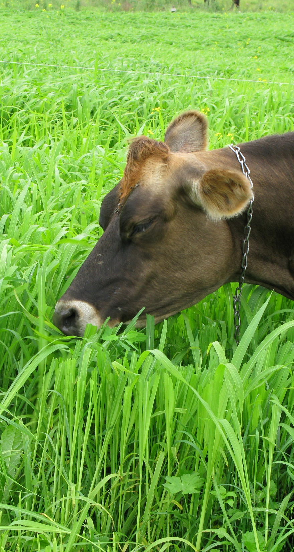
Human Subjects Research and Livestock Research
If you are gathering data from people or livestock, you will need to describe what type of data and how you will work with it so that we can be sure that confidentiality/welfare protections are in place as is required by USDA NIFA for research projects.
Japanese millet seed harvest
Brent Beidler, Beidler Family Farm, Randolph Center, VT (FNE07-597)

Slide 18
Tips for submitting a strong proposal
Consider the match between SARE and you
Start early
Need up to 40 hours?
Discuss with technical advisor well in advance.
Prepare your proposal offline
Review proposal before entering into on line system.
Write with reviewers in mind
Keep your writing clear and straightforward.
Develop a realistic budget
Request funds only for allowable expenses.
Remember the attachments!

Slide 19




Web Resources
northeastsare.org/FarmerGrant
Proposal instructions that give URL link to online submission system
Budget Narrative & Justification Template
Grant Commitment Form

Slide 20
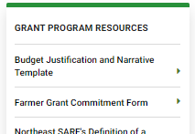
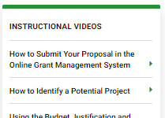
Web Resources
northeastsare.org/FarmerGrant
… and more!

Slide 21
If your project is funded
You, the farmer applicant, are considered the project leader or PI (Principal Investigator):
Point of contact for all aspects of award
Manage project according to plan of work
Manage budget and invoicing
  Funds are reimbursed after purchase of expense or labor expended.
  Reports – annual progress report due Jan 15; final report due 30 days after project end date

Slide 22
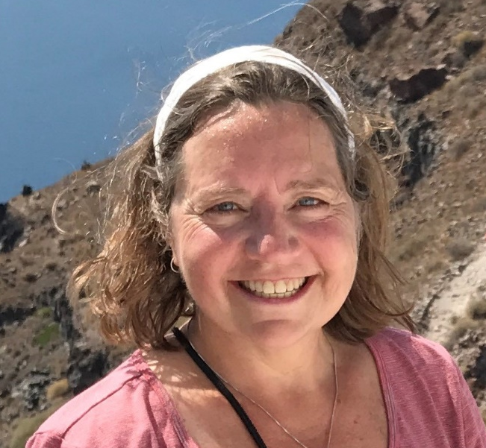

Questions?
Candice Huber
Grant Program Coordinator Farmer and Partnership Projects
802/651-8335 ext. 556
Candice.Huber@uvm.edu
For more information, visit:
www.northeastsare.org

