Slide 1
Calculating Forage Requirements and Yield
Bob Skalbite
Farm Manager, University of Massachusetts
3/11/2019

Slide 2
Key Concepts:
Identifying Livestock Type and Class
Determining Herd Forage Requirements
Determining Forage Yield
Planning for Shortage / Surplus
Utilizing Pasture Sticks and other Practices

Slide 3
Identifying Livestock Type and Class
To most accurately calculate forage needs:
Separate / Account for Livestock Based On:
Species
Age / Maturity
Projected Needs / Goals
Growth, Maintenance, Production
Example:
The Forage Requirements of a Cow w/ Spring Calf will Decrease throughout the season, while the Calf’s will Increase.

Slide 4
Calculating Forage Requirements:
How much forage does my herd need?
Daily Forage Requirement = #Animals x average weight x utilization rate
Example:
10 stocker steers x 500 lbs. x .04 = 5000# x .04 = 200 lb. / day.
Utilization Rate of 4%:
2.5% of body weight in dry matter intake
0.5% assumed trampling loss
1% buffer
Trampling Losses will increase the longer a herd remains in an area.
Livestock will overgraze good forages and avoid low quality forage in a large paddock
Aim to move animals to new pastures at least once per week.

Slide 5
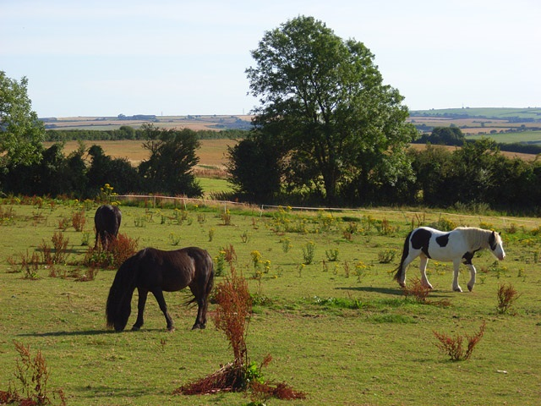
Calculating Forage Requirements

Slide 6
Calculating Forage Requirements:
How large should my pasture/paddock be?
Paddock Size = Herd DFR x Grazing Days / Available Forage Per Acre
Ex: 200# DFR x 3 Days / 1200 # Per Ac = .5 AC Paddock
How many days will a paddock last?
Days = Available Forage Per Acre x Paddock Size / Herd DFR
Ex: 1200 # / AC x .5 Ac Paddock / 200# DFR = 3 Days
How many animals will a pasture sustain?
Number = Available Forage per Acre x Paddock Size / Average weight x UR x Days
Ex: 1200# / Ac x .5 Ac Paddock / 500 x .04 x 3 = 10 Animals

Slide 7
Calculating Forage Requirements:
Monthly Forage Requirement:
MFR = DFR x 30 days (1 month)
Be sure to sum all livestock DFR in each herd
Example: 5 bred cows ,5 stockers/replacements:
DFR Cows = 5 x 1200 x .04 = 240#/Day
DFR Replacements = 5 x 600 x .04 = #120# / Day
Total DFR= 240# + 120# = 360#
MFR = 360# x 30 = 10,800# (5.4 Tons)
Remember: DFR / MFR will change as livestock:
Grow, Are Bought/Sold, Etc.

Slide 8
Calculating Forage Requirements
Livestock Kind/ Class | # Animals | Average Weight | Monthly Utilization (.04x30) | May | June | July | Aug | Sept | Oct
Beef Cow | 10 | 1200 | 1.2 | 14.4 | 14.4 | 14.4 | 14.4 | 14.4 | 14.4
Bull | 1 | 1600 | 1.2 | x | x | 2 | 2 | x | x
Stocker | 6 | 600 | 1.2 | 4.4 | 4.4 | 4.4 | 4.4 | x | x
Calves | 10 | 200 | 1.2 | x | x | x | 2.4 | 2.4 | 2.4
Totals | 27 |  |  | 18.8 (x1000lb.) | 18.8 | 20.8 | 23.2 | 16.8 | 16.8

Slide 9
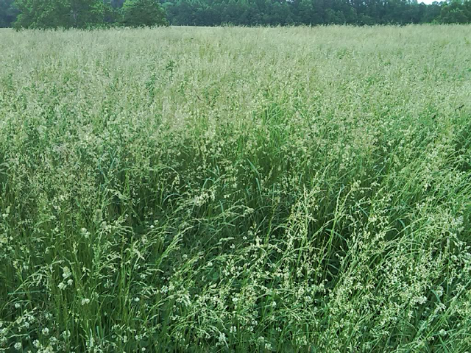
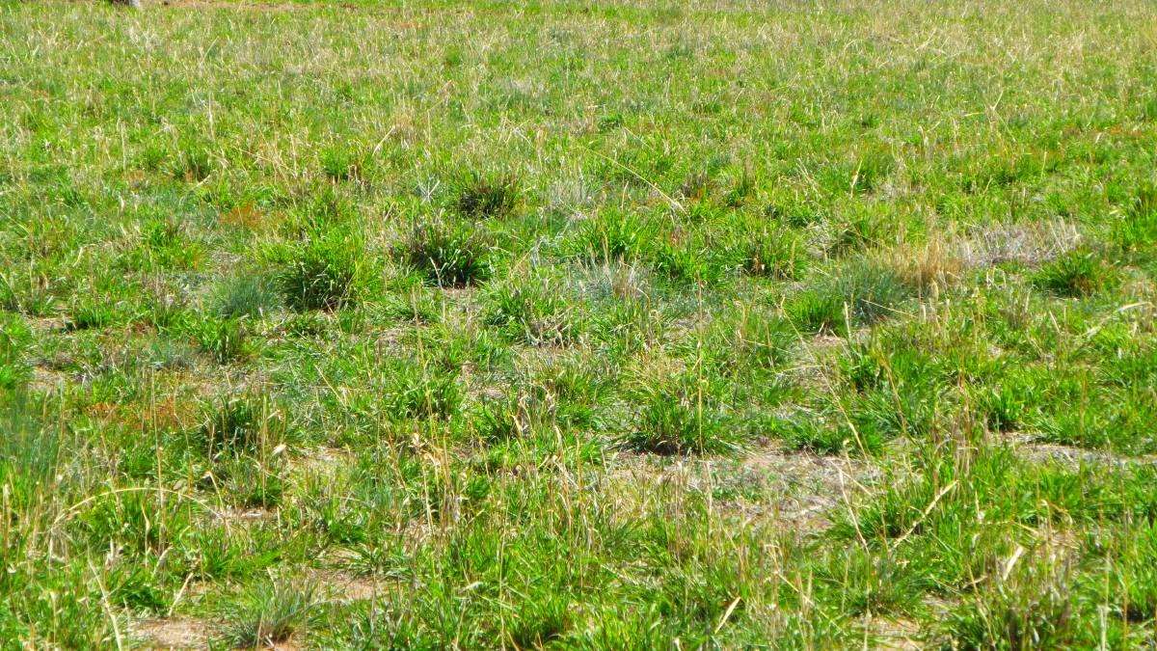
Forage Yield:
Forage Yield is affected by:
Species of forage present
Forage Maturity
Soil nutrition / PH
Grazing Intervals / Practices
Weather / Climate Conditions

Slide 10
Annual Forage Yield and Availability

Slide 11
Calculating Forage Yield:
To Calculate Forage Yield:
Identify Dominant Species in Field and Pasture Quality
Identify Annual Forage Production Per Acre
Identify Acreage and Determine Total Annual Yield
Identify Forage Availability (See Table)
Calculate Total Available Forage
Example:
10 Ac. Average Orchard grass Pasture in June:
4000x10 = 40000 x .35 = 14,000 # Yield / Availability for month of June

Slide 12
Monthly Forage Balance
Field | Forage | Yield | Acres | Total Yield | May | June | July | Aug | Sept | Oct
Prime | OrchardGrass | 6000 | 10 | 60 | 12 | 21 | 9 | 6 | 9 | 3
Poor | Reed Canary | 2700 | 15 | 40.5 | 8.1 | 12.15 | 8.1 | 4.5 | 6.1 | 1.9
Rent | Fescue | 4000 | 10 | 40 | 6 | 16 | 4 | 4 | 6 | 4
Total Available Forage (x1000) |  |  |  | 140.5 | 26.1 | 49.2 | 21.1 | 14.5 | 21.1 | 8.9
Total Forage Requirement (x1000) |  |  |  | 115.2 | 18.8 | 18.8 | 20.8 | 23.2 | 16.8 | 16.8
Total Surplus / Deficit (x1000) |  |  |  | 25.3 | 7.3 | 30.4 | 2.3 | -8.7 | 4.3 | -7.9

Slide 13
Planning for Shortage
When Facing a Shortage of Forage:
Determine Contingency Plan:
Feed Stored / Bought Forage
Sell / Reduce Herd Size
Increase Available Pasture (Rent)
Do NOT overgraze
Overgrazing will significantly reduce yields for the remainder of the season
Increase Paddock Size and Decrease Time Spent in Paddock
Use Sacrificial Areas when feeding stored forage

Slide 14
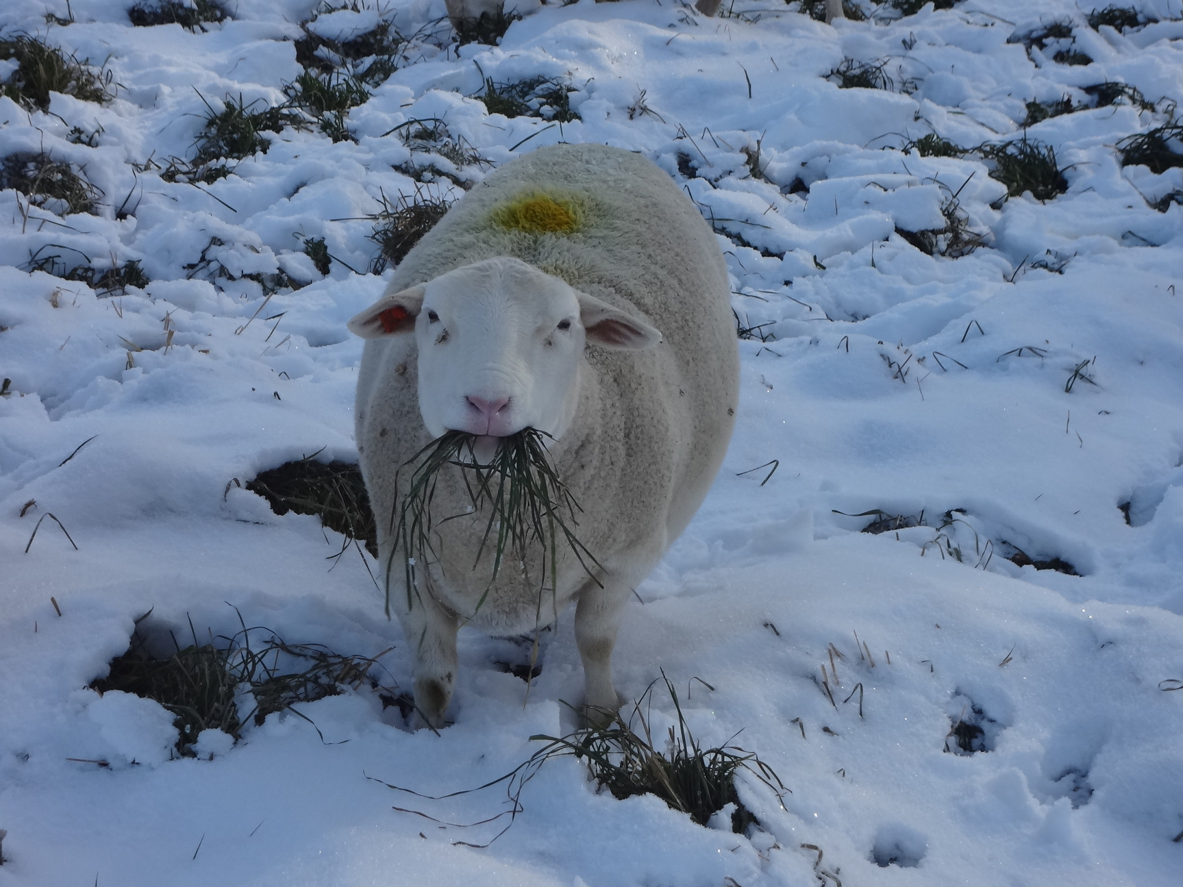
Planning for Excess
When Experiencing an Excess of Forage:
Harvest and Store (Hay)
Mow / Green Fertilizer
Increase Herd Size
Rent Out
Set Aside as Forage Reserve for Winter Grazing
Pay attention to Species, Growth Stage, Timing.
Do NOT Allow Forages to Mature past Boot Stage!
Once forages are allowed to mature re-growth is significantly slowed, affecting annual yields.

Slide 15
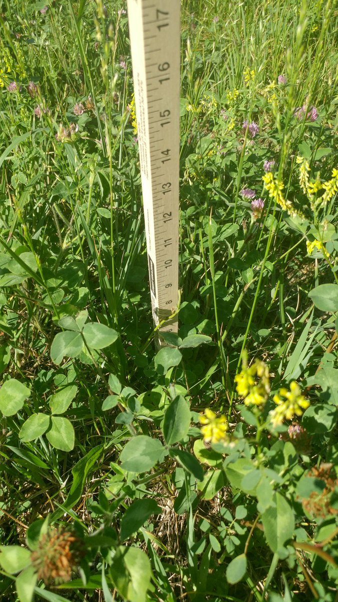
Out in the Field
Pen and Paper Calculations are only a guide
You Must check your pastures daily!
Utilize a Pasture Stick to monitor grazing and adjust practices:

Slide 16
Using A Pasture Stick
To Calculate Available Forage:
Measure from the average height of forage at the sample location
Subtract 3” (Maximum Depth of Grazing)
Depth may vary based on forage species
Identify the dominant species in the stand
Slide the stick underneath the forage at ground level
Count the number of visible dots
Multiply the number available grazing inches by the estimated #/AC
Ex: 8” total height – 3” = 5” x 250 = 1250# / AC
Multiply total available forage x paddock size
Ex: 1250# / AC X 1.5 AC = 1875# Forage Available

Slide 17
Using a Pasture Stick
Tips
Take at least 10 random samples per acre
Avoid false readings from areas of defecation or watering/feeding/sleeping areas.
When in doubt round down
It is better to leave a little extra forage than to overgraze
Keep Records of your measurements throughout the season
Review your records from previous years to determine if your pastures are improving in quality / yield.
Adjust practices if you find pastures are not improving on a yearly basis

Slide 18
Take– Away / Discussion
Calculate Daily Forage Requirements to Determine:
Paddock Size, Grazing Days, Number of Animals to Graze
Calculate Monthly Forage Requirements to Determine:
Total Pasture Needs
Times of Surplus and Shortage
Plan for Forage Surplus and Shortage
Establish Contingency Plans for Shortage
Determine how to Handle Surplus
Monitor Grazing Plans using pasture stick and observation

